Slide 1
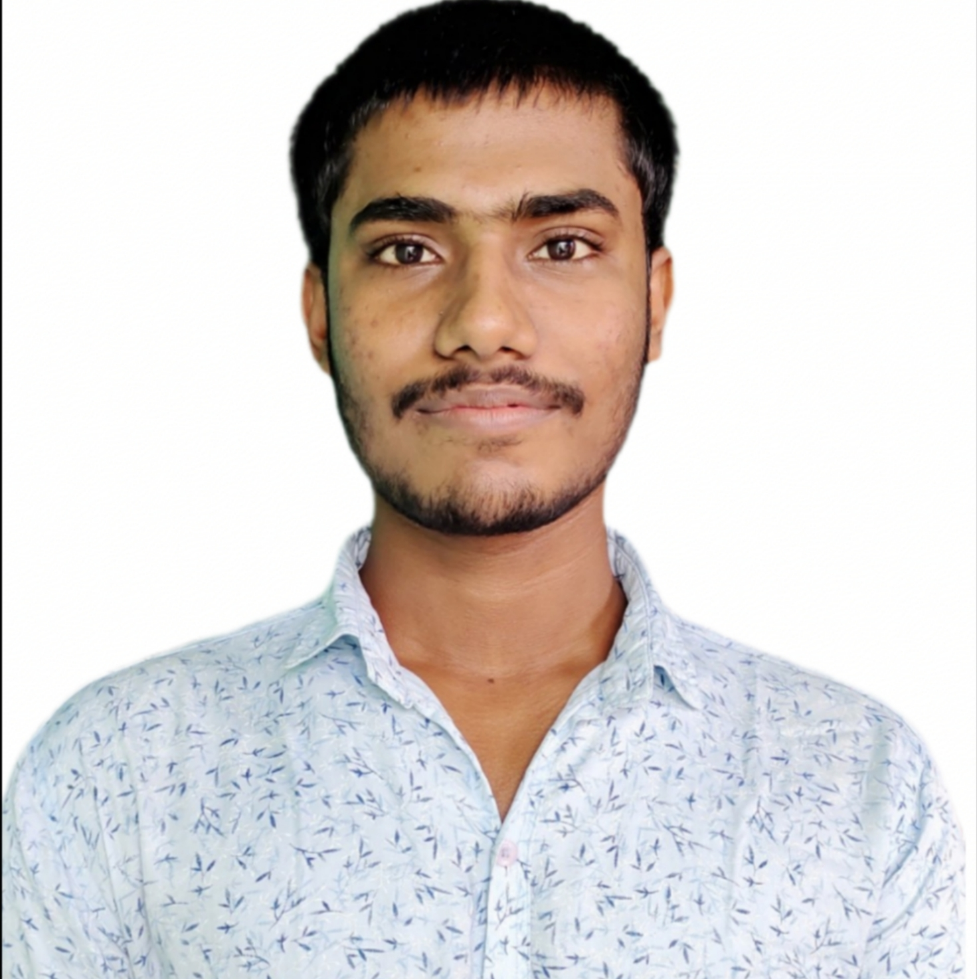

Suryakanta Kabi
Analyst/Software Engineer
Bachelor of Technology
YEAR:2017-2021
Skills
Core Java Spring Boot Microservices MongoDB ReactJS
Bangalore
Suryakanta.kabi@capgemini.com
+91 8249609557
A4
Database
No SQL database – MongoDB
Dedicated Software Engineer who is strong in design and integration with intuitive problem-solving skills.
Ready to learn new technologies and implement them to improve my knowledge.
Eager to work in a team of dedicated people and serve a key role in the enhancement and development of the project.
Good hands on experience on GIT, Mongo DB
Good knowledge on Java 8 and OOPs concepts.
Has working knowledge on ReactJS, SpringBoot and Java Microservice Development using Spring framework on an intermediate level.
ONLINE FLIGHT BOOKING SYSTEM
Successfully developed a complete case study on flight booking system using spring boot microservices as middleware, Mongo dB NoSQL database as backend and React Js as frontend.
Web Technologies
HTML5
CSS3
JavaScript
Bootstrap
Coursera Certificate
Add-Ons GitHub Maven Postman
Completed coursera course on HTML, CSS, and JavaScript for Web Developers.
Additional Details
Good Communication Skills
Problem-solving abilities.
Project management.

